Slide 1
Jelena Krmpotić-Nemanić

Slide 2
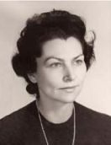
Prof. dr. sci. Jelena Krmpotić-Nemanić was born on March 15th 1921. in Sremska Mitrovica

Slide 3
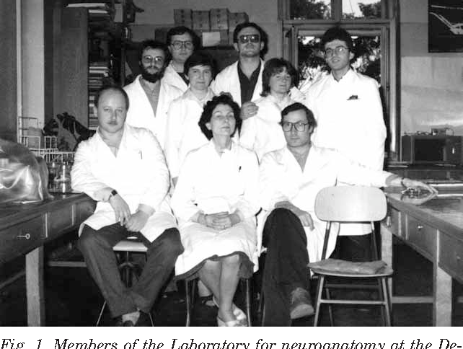
I 1948. she was named as the assistant proffesor for the subject „Human anatomy” in 1953 she was chosen to be an associate professor and in 1961 she became the headmaster of the anatomy department.
She got her Phd (on cerebellum endoplasty) in 1957 in Zagreb

Slide 4
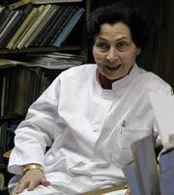
In 1957 she was rewarded by the National medical academy in Paris for her discovery of the neuromusculary chronometrical index and was given the ‘laureate’ title.
She also speaks more than 6 languages

Slide 5
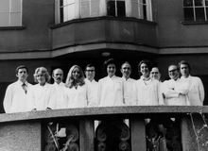
Jelena was a storng woman and a brilliant scientist. Being a woman who works in that area definitely wasn’t easy back then so I would say that she is admirable and I am honoured to say that a Croatian woman has had such a powerful role in the history of medicine

