Slide 1


Our Planet’s Future
World Summit – OCTOBER 23
İSTANBUL
İstanbul Atatürk Fen Lisesi
STEPS Towards Ecological Planet 2022-1-FI01-KA220-SCH-000086671

Slide 2

WORLD LEADERS…
World Leaders have a fund of 100 Billion ‘World Dollars’ (WD), split equally between the group in 5 Billion tokens.
They will make an opening speech before the presentations of experts. 2 min.
They will listen to the briefings on food, energy and health – Presentations of the experts.
They must decide how to invest the available budget, and what agreements to put in place, in order to ensure a positive future for the world population.

Slide 3

World leaders…
World Leaders will decide where to invest and whether to change their plans for ENERGY, FOOD and HEALTH.
And will present their agreed PLAN.

Slide 4

Our Planet Experts
Our Planet Experts split into small groups,
Will research the biomes of our planet,
Will present evidence to the world leaders to inform and influence their decisions on how to invest their budget and define the future of society.

Slide 5
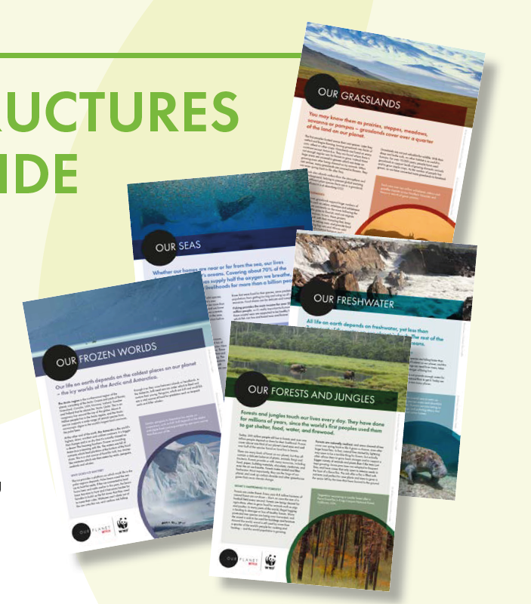
EXPERTS will discuss their biome or topic area (using the briefings provided and conducting internet research if time allows) and prepare a short (5 minute) presentation for the World Leaders
Grassland Experts
Oceans/Seas Experts
Freshwater Experts
Forest Experts
Frozen World Experts
ON MONDAY – DURING THE GROUP WORKS groups will work on their presentations. All experts need to be prepared for their biomes.

Slide 6
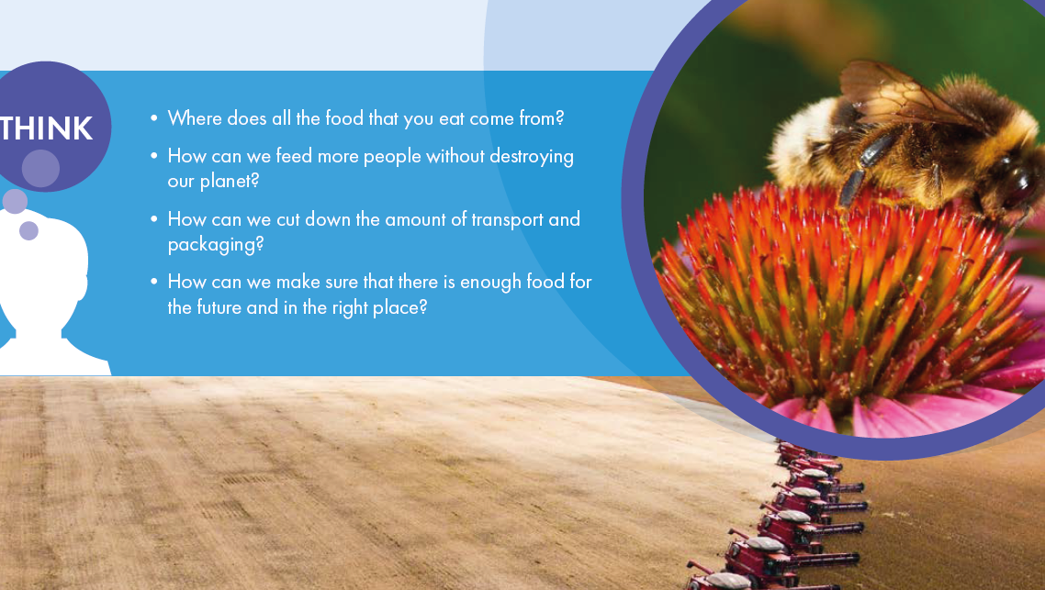
Briefing Topic One: FOOD

Slide 7
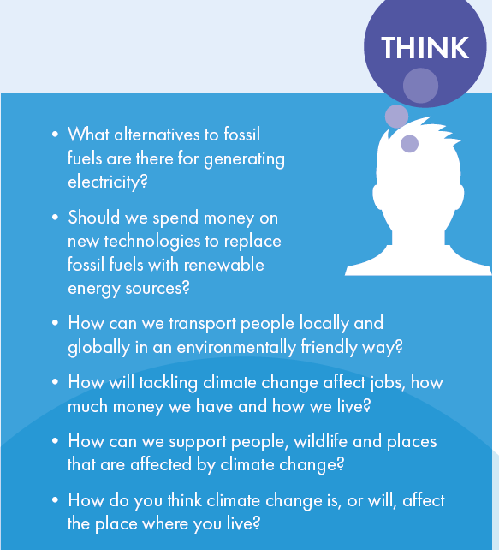
Briefing Topic Two: ENERGY AND CLIMATE CHANGE

Slide 8
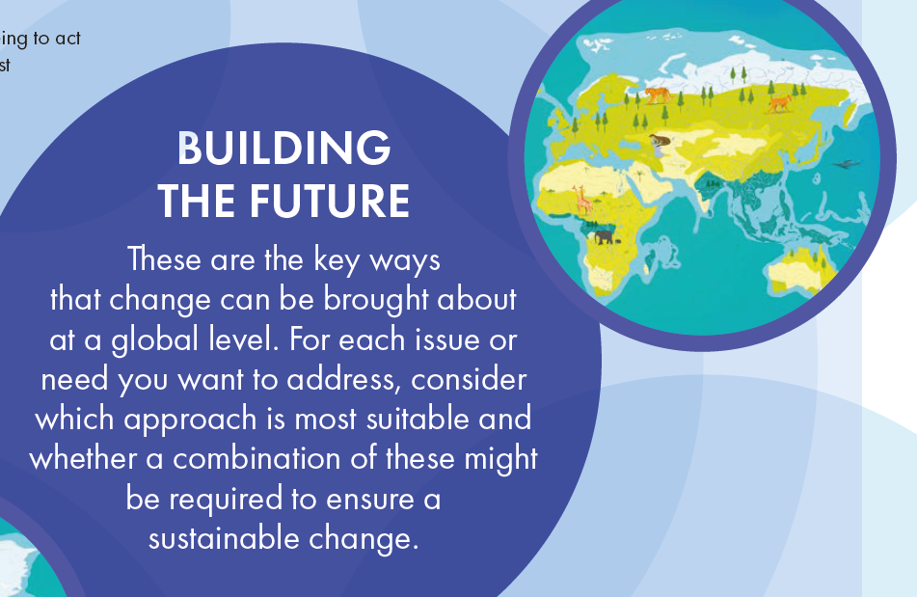
Briefing Topic Three:
HEALTH AND HAPPINESS

Slide 9
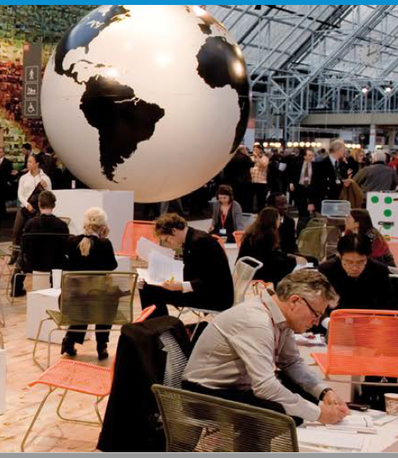
SUMMIT PLAN
Friday – 10:30 am
Our Planet’s Future Summit opening remarks (Chair: Berra)
The World Leaders’ speech to present their priorities, initial action plans and budget allocations for the next 10 years. (5 mins)
The chair lets expert to make their presentations:
Each group of Our Planet Experts then presents about their biome and puts forward their recommendations to World Leaders for actions, changes and investments that will protect their biome and benefit human society and wildlife.
After all the presentations, Lunch Break.
World Leaders will have time to discuss and work on their PLAN. A draft copy will be provided.

Slide 10
EXPERTS
EXPERTS of | FI | CR | ES | TR | TR
GRASSLANDS | Sakari | Lana | Sara Lan Zhan | Rabia Azra | Ada
OCEAN | Lotta | Mila Cukon | Fernando Campillo | Dila Çiçek | Umay
FROZEN WORLDS | Arsi | Sara | Zoe Sierra | Lizge | İrem Naz
FRESH WATER | Lene | Vitomira Vuljak | Lucía López | Leylanur | Melih Fazıl
FORESTS | Elli | Vito Križnjak | Pablo Aguilar | Yiğit | Beyza

Slide 11
WORLD LEADERS
WORLD LEADERS of
ABANASSIA | Matias - FI
BANTAROS
NUMERICA | Rüzgar Pars - TR
PEZZADOR | Klara Skeledjic-CRO
SHAO PO | Gamze - TR

Slide 12
Biome Tour Videos
Forests:
https://www.ourplanet.com/en/video/biome-tour-of-our-forests/
https://www.ourplanet.com/en/video/biome-tour-of-our-jungles/
Ocean:
https://www.ourplanet.com/en/video/biome-tour-of-our-coastal-seas/
Grasslands:
https://www.ourplanet.com/en/video/biome-tour-of-our-grasslands/
Frozen Worlds:
https://www.ourplanet.com/en/video/biome-tour-of-our-frozen-worlds/
Fresh water:
https://www.ourplanet.com/en/video/biome-tour-of-our-freshwater/

